Slide 1

Predictive Cyber Defense
Early Warning Intelligence & Forecasting
Notes:
Welcome everyone, and thank you for joining today's presentation on 'Predictive Cyber Defense'. Special thanks to Katie for hosting me here on this webcast. Our focus today centers on a concept I term 'predictive cyber defense.' We will delve into how predictive analysis techniques can be applied to anticipate both short-term and long-term cyber threats.

Slide 2

Whoami?
Red Team Lead @ HelloFresh
Member of Curated Intel
Twitter t : @1ce7ea
LinkedIn : linkedin.com/in/robin-dimyan/
Website : robindimyan.medium.com

Slide 3
Program Agenda
1. What is Predictive Defense?
2. Predictive Analysis Techniques
3. Early Warning System
4. Forecasting Cyber Crime
5. Geopolitical Cyber Risk Analysis

Slide 4
Reactive vs. Proactive vs. Predictive Defense
Reactive:
The attack has started and we might be a potential target.
Proactive:
The attack hasn't started yet, but it might target us when it does.
Predictive:
The attack is expected to start within a certain time frame and we could be a target.
Notes:
Reactive: “There’s an ongoing campaign and here are the IOC’s. Let’s hunt for these in our network and feed this info to our prevention systems.” (Tactical decision making)
Reactive: “We've faced numerous DDoS attacks causing downtime this year. Let's invest in a DDoS protection solution next year.” (Strategic decision making)
Proactive: “There’s an actor known to target our industry and here are the TTPs they’re likely to use. Let’s build detections around these and prioritise the patching of ABC vulnerabilities.” (Tactical decision making)
Proactive: “Based on our attack surface and threat models, exposed secrets are one the most impactful threats we could face. Let's plan to implement a secret management solution next year.” (Strategic decision making)
Predictive: “There’s a high probability of an XYZ attack occurring in the following [time] period. Let’s formulate a preparation plan to lessen its impact and enhance our response.” (Tactical decision making)
Predictive: “We anticipate that cybercriminals will shift from credential stuffing to cookie/session-based attacks in the coming years due to X, Y, and Z reasons. Let's initiate a plan to address session management issues in our systems next year.” (Strategic decision making)

Slide 5
Predictive Analysis Techniques
Indications and Warnings Analysis
Cone of Plausibility
Signpost Analysis
Correlation-based Techniques
Bayesian Probability
Notes:
Analytic techniques:
I&W Analysis
Cone of Plausibility
Signpost Analysis
Statistical approach:
Correlation-based techniques
Bayesian probability

Slide 6
Research Questions
“How can I detect the upcoming spear-phishing attacks?”
“How can I identify the vulnerabilities that are most likely to be exploited in the wild?”
“How can I predict what kind of threats will be more relevant to me in the future?”
“How can I foresee the development of a cyber crime market which targets my organization?”

Slide 7
Research Questions
“How can I detect the upcoming spear-phishing attacks?”
Are there any early signs of a spear-phishing campaign that I can observe?
“How can I identify the vulnerabilities that are most likely to be exploited in the wild?”
What factors are influential in adoption of a vulnerability by the attackers?
“How can I predict what kind of threats will be more relevant to me in the future?”
What influences targeting decisions by the adversaries?
“How can I foresee the development of a cyber crime market which targets my organization?”
What drives a change in the TTPs of adversaries?

Slide 8
EARLY WARNING SYSTEM
Introduction to Research Methodologies

Slide 9
Research Approaches
1. Profile-driven research
You profile certain attack types or campaigns and use these patterns to predict future attacks.
2. Correlation-guided research
You look for correlations between different events and attack types without profiling.
Then, you investigate any correlation you have found to construct your hypothesis.
Notes:
1. Profile-driven research
You profile certain attack types or campaigns and use these patterns to predict future attacks.
2. Correlation-guided research
You look for correlations between different events and attack types without profiling.
Then, you investigate any correlation you have found to construct your hypothesis.
Are there any correlations between external events and certain type of attacks?
E.g: Does more mentions in the Dark web translate to higher likelihood of attack?
This time you collect data as a first step about the events that you think might be related

Slide 10
Profile-driven Research
Case study: Spear-phishing attacks

Slide 11
Spear-phishing Attacks
An adversary's possible preparation steps for a spear-phishing attack:
Curating a list of employees to be targeted
Scraping public websites, LinkedIN etc.
Interrogating the identity services (Azure-AD, LDAP etc.)
Interrogating the email server/provider
Setting up the phishing infrastructure
Malware host / landing page
Staging and C2 servers
Domain names, SSL certs
Setting up the distribution method
Bulk email services (Mailchimp etc.)
Self-hosted email server
Known email providers (Gmail etc.)

Slide 12
Profiling the Spear-phishing Attacks
Defender's perspective
Look for patterns in the phishing instances you received. It doesn’t have to be a single pattern across all instances, you will probably have multiple clusters.
What is the mean time between two spear-phishing attacks?
What is the distribution of these attacks throughout the year?
How many employees are targeted in each cluster?
Which malware families do I receive through these phishings?
What do landing pages look like? Is it possible to fingerprint them?
Notes:
What is the mean time between two spear-phishing attacks?
E.g: Twice every month
What is the distribution of these attacks throughout the year?
Any specific seasons or time frames these attacks surge?
What type of phishing do we usually receive?
Credential phishing? Malware phishing? Both?
How many employees are targeted in each cluster?
Any noticeable focus on certain departments, roles or geographies?
Which malware families do I receive through these phishings?
E.g: Trickbot and RedLine
What do landing pages look like? Is it possible to fingerprint them?
Any known phishing kits? Anything custom?
Are there any patterns within the infrastructure?
Port combinations that are uncommon?
Specific server banners? Page titles? Domain names following a pattern?
Common SSL certs, ASNs etc?

Slide 13
Example: Leery Turtle Campaigns
Spear-phishing campaigns targeting crypto-exchange businesses worldwide that are later attributed to North Korea.
Domain names used in Leery Turtle campaigns contain at least two of the following words: google, drive, cloud, share, upload.
Leery Turtle staging servers had ports 80 and 8080 open at the same time because they were compromised web apps.
There were approx 3 months between two campaigns
These patterns have remained consistent for at least two years!
Reference: https://github.com/robindimyan/Publications/blob/master/LeeryTurtle%20Quick%20Analysis.pdf

Slide 14
I&W Analysis
Mail / Identity servers
Infrastructure pivoting
Vendor reports / OSINT
Monitor for interrogation of your identity/email services.
New domains fitting the pattern
New servers with similar config
Recent reports of the same campaign that are of interest
New infrastructure
New malware samples
Campaign start
Scan the internet to spot new infrastructure based on the profiles
Monitor malware families that are of interest using open sources

Slide 15
Building the Early Warning System
Data analysis!
Extract a history of these signals retrospectively (if possible)
Compare with the history of spear-phishing attacks you have received
Try different weights and combinations to see which model makes the best prediction
You can use mean-time between two attacks as the signal lifetime
You can also use mean-time between attacks to schedule threat hunts!
Sometimes the model is not good enough, so you may have to start over
Reference: https://robindimyan.medium.com/early-warning-intelligence-how-to-predict-cyber-attacks-1299af2dada3

Slide 16
Correlation-guided Research
Case study: Infostealers and credential stuffing

Slide 17
Collecting Data
Darkweb mentions
Intelligence platforms
SIEM events
Infostealer leaked creds
Coupon code sales
Open source intelligence
Reported phishing emails
Web Application Firewall
DDoS attacks
Web exploit attempts
Azure logs
Internal reports
Azure risky sign-ins

Slide 18
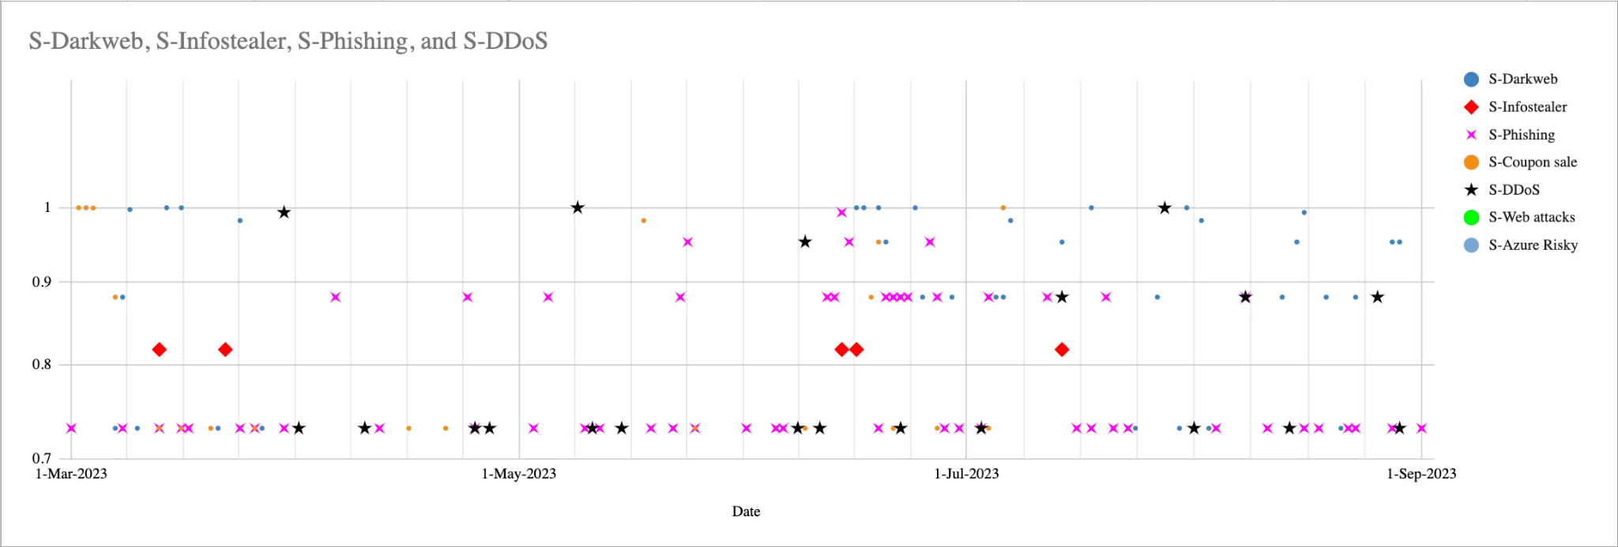
Correlation-guided Research
Reference: https://robindimyan.medium.com/how-to-build-early-warning-system-with-examples-692b66fa73d6

Slide 19
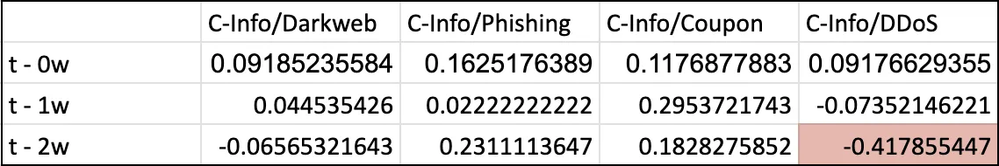
Correlation-guided Research
The second step is to filter out data sets with low variation among them.
An event that occurs almost every day renders any correlation with itself meaningless.
Afterward, the binary combinations of these events are compared using a correlation function.
Notes:
This process is them repeated by shifting one of the compared data sets forward in time. In other words, we’re attempting to find an answer to the question, ‘Is there a correlation between the event A from one week ago and the event B today?’
When the data is shifted by two weeks, a moderate inverse correlation between Infostealer and DDoS events is observed.
What this data is telling us is that some of the DDoS attacks were happening in the midst of two Infostealer-related credential leak events.

Slide 20
Constructing the Hypothesis
New infostealer leak
or data breach
Update combolist
with new
user / pass
Launch the attack
If accounts belonging to our organization or our customers have been leaked in publicly shared Infostealer logs (and data breaches), there is a 40% probability that a DDoS/credential stuffing attack will occur within two weeks.
Notes:
Upon a closer look to the DDoS incidents, some of the events classified as DDoS attacks turned out to be credential stuffing attacks!
The attack's execution involved making repeated requests to the system, and the WAF was categorising them as DDoS attacks.
With a bit of research it was found that attackers commonly create custom username/password lists tailored to the platforms they target. They used various sources, including data breaches and Infostealer logs. These public sources were easy pickings for the attackers!

Slide 21
I&W Analysis
Infostealer and data breaches
Identify customer accounts
Alerting
Identify and monitor sources where Infostealer logs and data breaches are publicly shared
Detect leaked accounts belonging to our organization and customers
Generate alerts if the number of these compromised accounts exceeds a certain threshold

Slide 22
Key Takeaways
Identifying early signs of an attack is possible if we focus on its preparatory stages.
Developing early signals involves analysing internal data to understand the characteristics of cyber attacks and identifying patterns or correlations.
A well-developed warning model using these signals can predict events with a degree of probability, giving defender teams ample time to prepare.

Slide 23
FORECASTING
Analytic Frameworks for Cyber Crime and Espionage

Slide 24
Forecasting
Assessment of “what’s next?” in long term (1+ year)
Ideally should inform security leadership decisions so the organization is better positioned against future threats.
Some analytic frameworks from traditional intelligence analysis: PESTLE-M, DIMEFIL, STEMPLES+
Notes:
Analysis techniques are there, but in CTI we are lacking the analytic frameworks to analyse cyber crime and interstate cyber conflict from a systems point-of-view.

Slide 25
Cyber Crime Forecasting
Analysing cyber crime markets by understanding its drivers

Slide 26
Cyber Crime Market Dynamics
Consumer habits
Value of commodities
Innovation
Expanding target range
Migration
Drivers of Change
Market Response
Proliferation of capabilities
Consolidation
Legal-technical measures
Expansion
Law enforcement pressure
Reference: https://robindimyan.medium.com/predictive-defense-how-to-do-cyber-crime-forecasting-with-examples-548c22e4a4e5

Slide 27
Cyber Crime Forecasting
STEP 1
Choose a market and conduct basic market research
Market research
STEP 5
STEP 2
Observe darkweb sources for emergence of scenarios
Monitoring
Change in drivers
Assess possible changes in the market drivers
STEP 4
STEP 3
Determine signposts of change to monitor for scenario emergence
Signposts of change
Scenario ideation
Brainstorm scenarios for potential outcomes

Slide 28
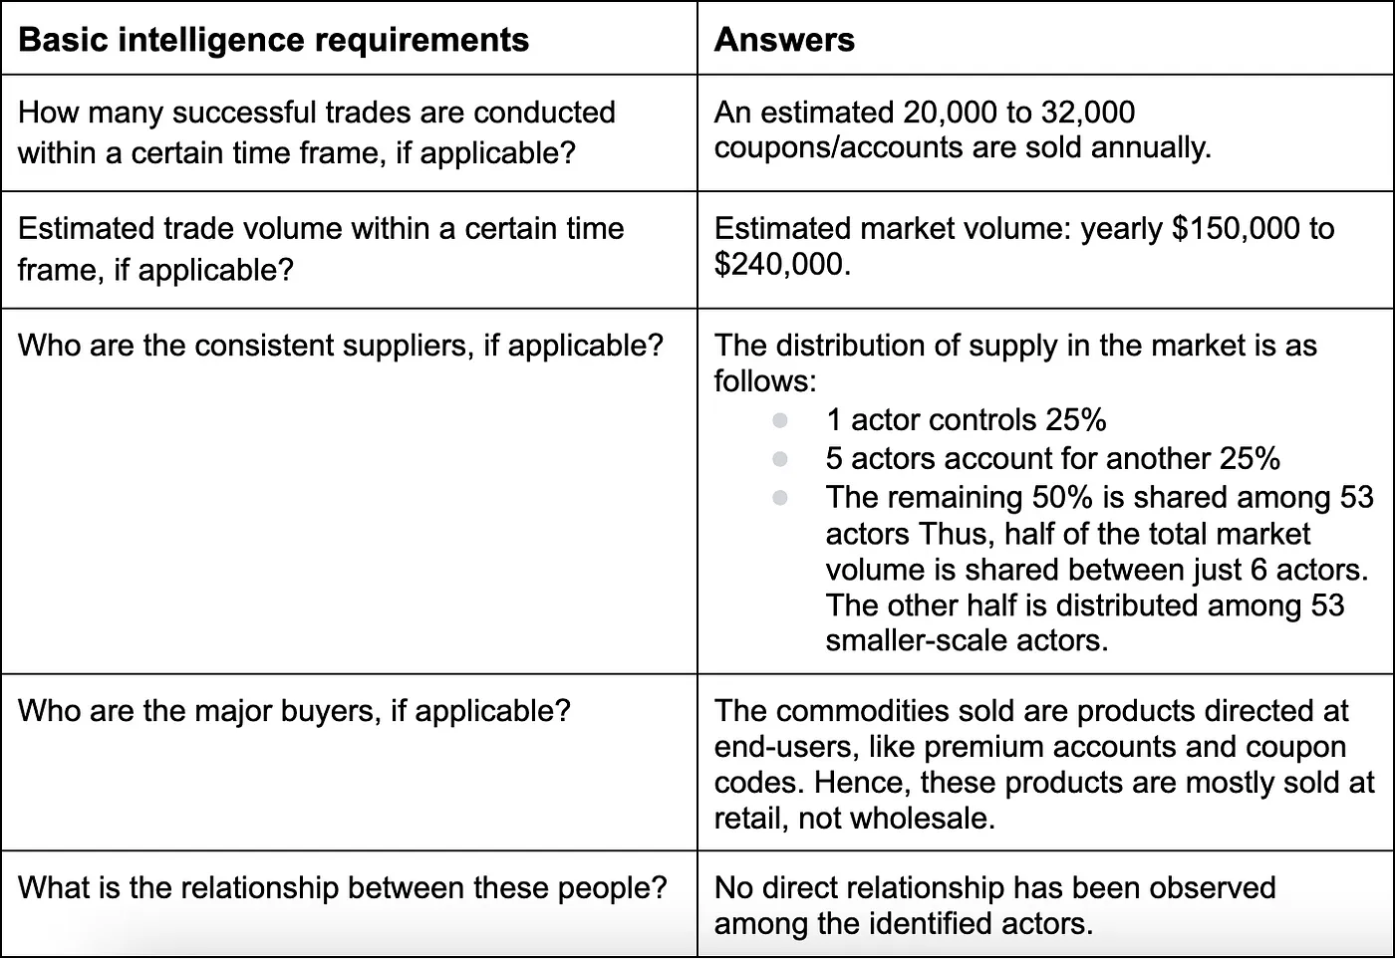
Credential Stuffing Market
Step 1: Choose a market and conduct basic market research

Slide 29
Cone of Plausibility
Step 2: Assess possible changes in the market conditions
Step 3: Brainstorm scenarios for potential outcomes of changed conditions
DRIVERS | QUESTION | ASSUMPTION | OUTCOME
Consumer habits | Is there a reason for consumer habits to change in the future? | Post the COVID-19 pandemic, there is a decrease in consumer demand for digital products and services. | With their source of income diminishing due to decreased customer demand, criminals migrate to other markets, such as initial access brokerage, where they can repurpose their skills. (migration)
Reference: https://robindimyan.medium.com/predictive-defense-how-to-do-cyber-crime-forecasting-with-examples-548c22e4a4e5

Slide 30
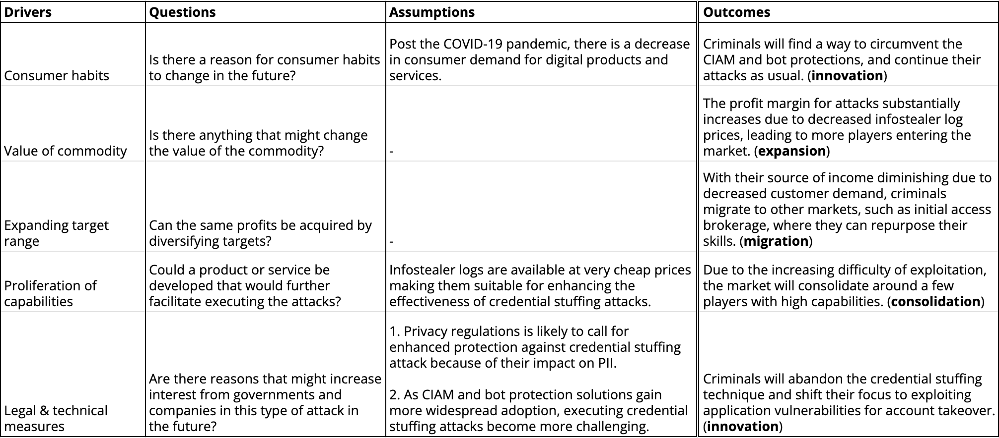
Cone of Plausibility

Slide 31
Signpost Analysis
Step 4: Determine signposts of change to monitor for scenario emergence
With their source of income diminishing due to decreased customer demand, criminals migrate to other markets, such as initial access brokerage, where they can repurpose their skills. (migration)
Signposts of change:
# of messages containing coupon sale related keywords decreases over time
Known coupon retailers starts selling other commodities

Slide 32
Key Takeaways
Financially motivated cyber crime is influenced by market-like forces of supply and demand.
It's essential to understand the factors driving supply and demand, like consumer behavior, commodity value, and legal and technical measures, to effectively analyse cyber crime markets.
Markets react to changes in these conditions with patterns such as innovation, migration, consolidation, or expansion.
Notes:
SAT's like the Cone of Plausibility and Signpost Analysis are effective for assessing the impact of changes on specific markets, provided foundational market research has been conducted.

Slide 33
Geopolitical Cyber Risk Analysis
Understanding different types of intelligence collection

Slide 34
Different Types of Intelligence Collection
Military Intelligence
Comms Intelligence
Economic Intelligence
Political Intelligence
Financial Intelligence
Technical Intelligence
Geospatial Intelligence
Reference: https://robindimyan.medium.com/geopolitical-cyber-risk-going-beyond-the-industry-and-region-3581465c7e3f
Notes:
An effective threat model should determine whether anything an organization possesses concerns the political, economic, scientific, and military objectives of other countries.
Political intelligence:
Does my organization contribute to the policy-making of its home country?
Are there any individuals within the organization who is influential in policy-making?
Do any of the companies we are in business with meet any of the above conditions?
Economic intelligence:
Does my organization engage in significant export activities?
Does my organization conduct business outside of its home country?
Does my organization provide products or services to governments of other countries?
Does my organization possess an intellectual property that provide a significant commercial advantage?

Slide 35
Strategic vs. Tactical Collection
A target may be capable of:
Supplying information that supports long-term policies.
Fulfilling several intelligence requirements simultaneously.
Offering information that an agency consistently requires.
Targeting is expected to be persistent, adaptive and long term, but unlikely to employ advanced, event-based capabilities.
A target may be capable of:
Fulfilling intelligence needs that are immediate and critical.
Providing information that an agency is unable to obtain through alternative sources.
Targeting is expected to be persistent and adaptive, and more likely to employ advanced, event-based capabilities.
STRATEGIC
COLLECTION
TACTICAL
COLLECTION

Slide 36
Beginning
STEP 1
Consider your business and see if there is anything about you that may concern political, economic or military interests of any country
STEP 2
Try to identify the countries whose interests may lead their intelligence services to target you. Try to get more specific about why they might target you

Slide 37
STEP 3
For each country, try to understand what kind of collection effort you’re more likely to be a target of; strategic, tactical, or both
STEP 4
Map all these information with the cyber capabilities of each country
End

Slide 38
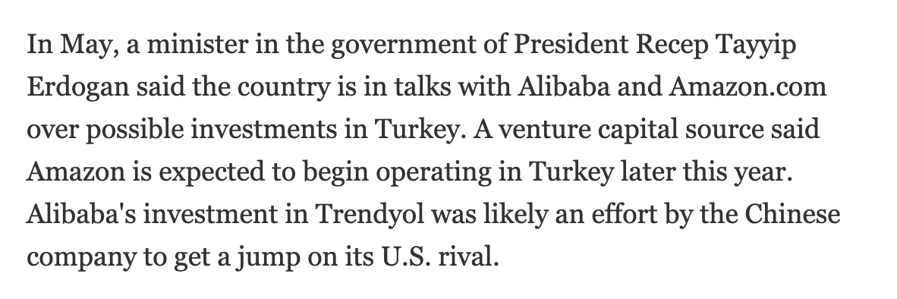
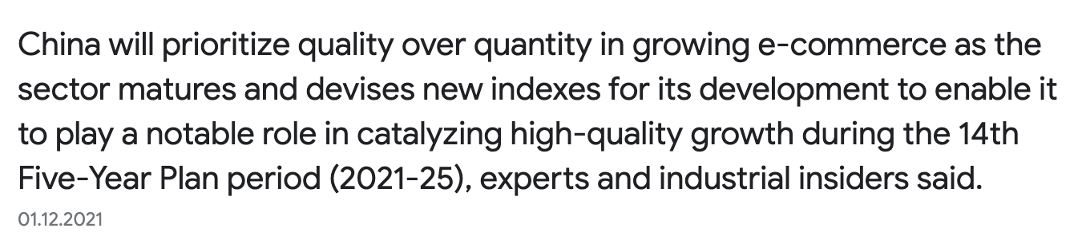
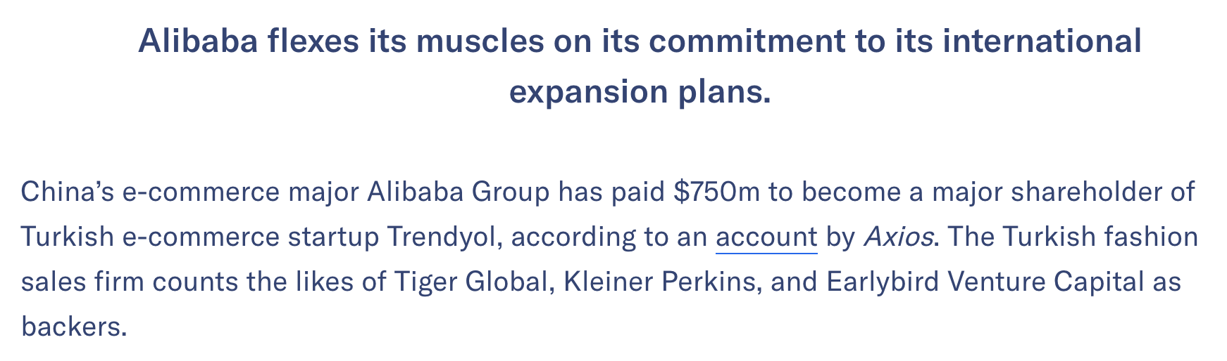
China's Foreign Investments
July 17, 2018
1 Dec, 2021
Aug 15, 2018
Notes:
E-commerce industry is a highly competitive arena on the international stage, particularly between the United States and China. For instance, when Amazon showed interest in entering the Turkish market, Alibaba swiftly acquired Turkey's leading e-commerce company, Trendyol. This move highlights the strategic importance of e-commerce in the global rivalry between the two countries. Even today, China's 14th Five-Year Plan clearly demonstrates the country's continued focus on boosting investments in the e-commerce sector.
China's tactic of expanding through mergers and acquisitions in different countries makes e-commerce companies in these regions potential targets for economic intelligence, as they play a crucial role in China's efforts to gain a competitive edge.
Apart from this example, international politics isn't the only factor that can introduce threats. In fact, a company's own business decisions can also significantly impact its threat landscape.
Consider a scenario where you are employed at a company that produces automobile parts. This company has decided to bid for a government contract to create components for a military system. If your company is successful in winning the bid, it will likely attract new threat actors tasked with gathering intelligence on defense systems.

Slide 39
Key Takeaways
Nation-state cyber intrusions typically fall into three categories: denial (military), coercion (diplomatic), and espionage.
The motives behind cyber espionage are shaped by a nation's political, economic, and military objectives.
Businesses may be targeted by intelligence agencies if they hold assets related to these objectives, such as products, information, employees, customers, or access.
Notes:
Businesses can leverage this logic for threat modelling and interpret new state policies as potential intelligence requirements, aiding in forecasting.

Slide 40
Questions?
robindimyan.medium.com

